Slide 1
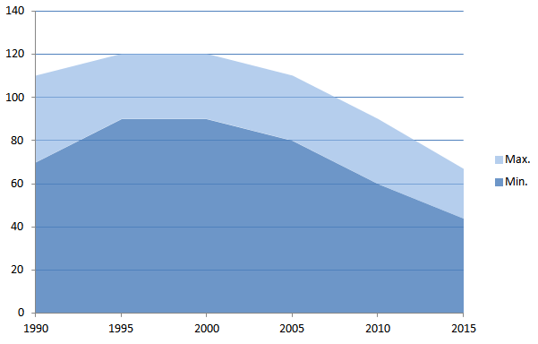
Dental amalgam: Mercury releases and cost implications
Peter Maxson
Director
Concorde East/West Sprl – Brussels
Presentation at the workshop:
Promoting Dental Amalgam Phase-Down Measures Under the Minamata Convention and Other Initiatives, for “Especially Women, Children and, Through Them, Future Generations”
Bangkok , 14-15 May 2018

Slide 2
Overview
Pathways of dental mercury to the environment (and to people)
Environmental impacts of mercury exposure
Health effects of mercury exposure
The real costs of using dental amalgam

Slide 3
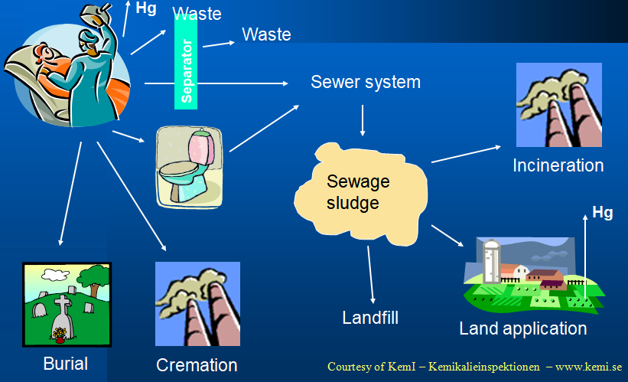
Simplified diagram of dental mercury pathways
Notes:
Basic pathways of dental mercury from the clinic to the environment...
We tend to think that dental mercury mostly goes into the mouth of the patient, and more or less stays there until a person dies. But a close examination of the mercury life-cycle shows that nearly 80% of the dental mercury used every year goes into the solid (municipal or hazardous) waste and wastewater streams.

Slide 4
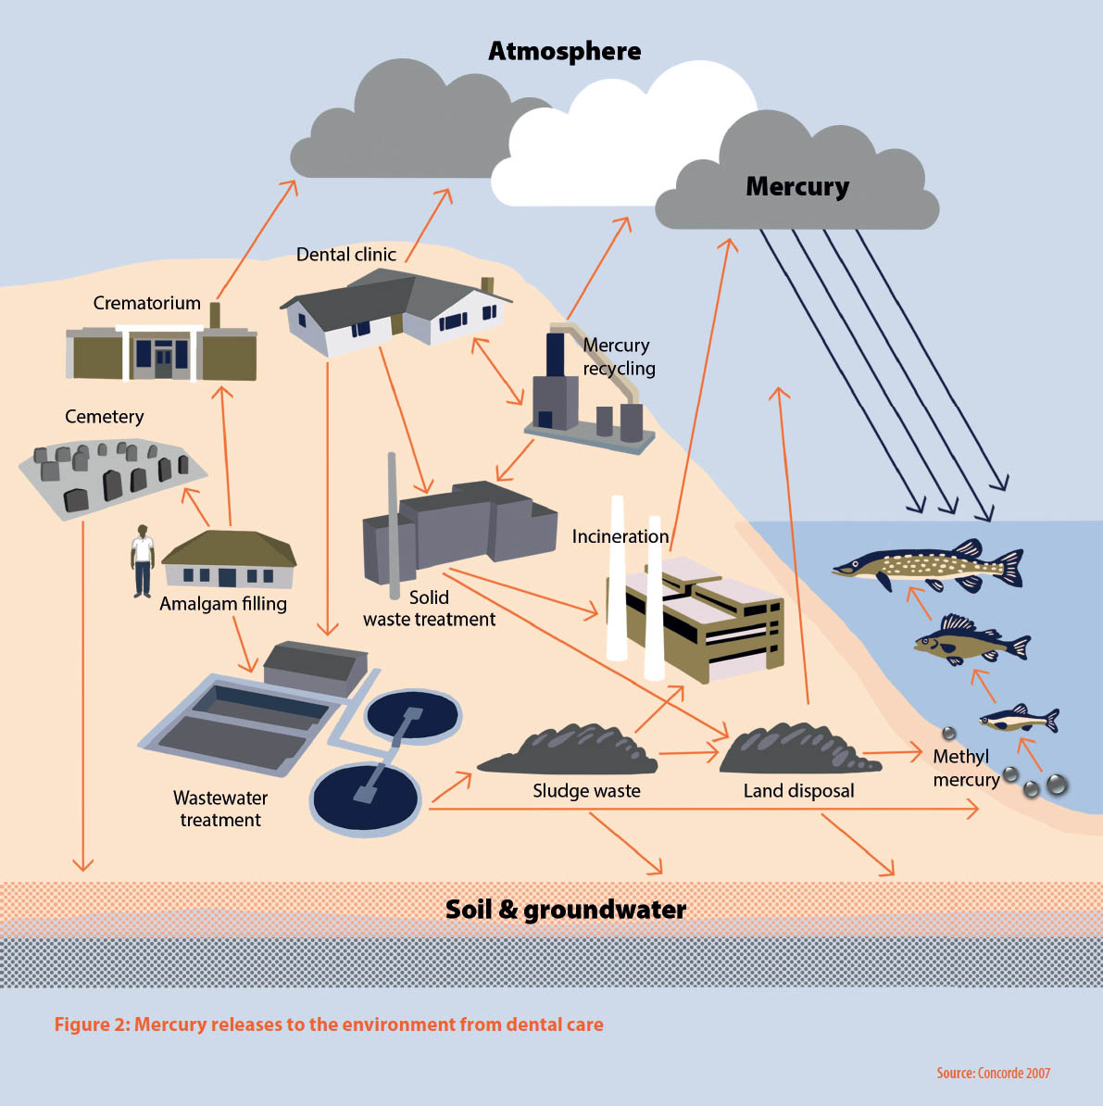
Dental mercury pathways to the environment
Notes:
Pathways of dental mercury through the global economy and environment include: Mercury supply sources such as mines, recycling operations and mercury used in the chlor-alkali industry; Global mercury brokers and traders; Manufacturers and suppliers of dental materials to the dental trade…
And as shown in this diagram, placement and removal of amalgam fillings in dental practices; Recycling, storage or simple discard of dental mercury wastes; Burial of the deceased and eventual mercury releases to soil and water; Cremation of the deceased and mercury emissions to the atmosphere.
In summary, when dental amalgam is used, mercury will be released to the air, water and land, and some of it will eventually be taken up in fish and other living things, including humans.

Slide 5
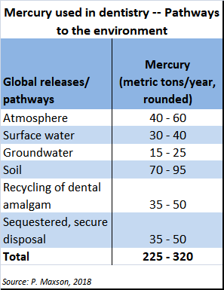
Notes:
Extrapolated from an analysis for the Global Mercury Assessment, AMAP/UNEP, 2013.

Slide 6
Mercury and the environment
Inorganic Hg (from natural or anthropogenic sources) becomes toxic in the environment when it is converted to methylmercury (MeHg) by sulphur-reducing bacteria and other microbes (Gilmour et al. 2013).
Certain ecosystem conditions (e.g. wetlands) can encourage the production and bioavailability of MeHg.
Potent neurotoxin that can cause physiological, neurological, behavioural, reproductive, etc. harm to fish and wildlife (Scheuhammer et al. 2011).
Efficient biomagnifier, resulting in increasing concentrations of MeHg in the ecosystem as it moves from water and sediment, to phytoplankton and plants, aquatic insects, spiders, fish and wildlife.

Slide 7
Mercury and human health
Everyone is exposed to some degree
Adverse health effects depend on the chemical form, concentration, duration, life stage, etc.
Consensus: developing organs are the most sensitive
Mercury exposure impairs a range of physiological systems, especially:
  elemental mercury: nervous system (tremors, emotional lability,* neuromuscular changes, polyneuropathies)
  inorganic mercury compounds: renal system
  methylmercury: neurodevelopmental effects, cardiovascular system, etc.
  * rapid, often exaggerated changes in mood
References: Ha et al. (2017), Karagas et al. (2012), WHO/UNEP/IOMC (2008), Mergler et al. (2007), Clarkson and Magos (2006), the U.S. CDC’s ATSDR (1999), and U.S. EPA (1997).

Slide 8
Occupational and patient exposure
Direct mercury exposure via:
hand-mixing of mercury and metal powders
drilling of old amalgam fillings
extraction of teeth with amalgam
solid waste disposal bins
slow release of mercury from fillings already in place
emissions into clinic from wastewater system

Slide 9
Other human exposure
Indirect exposure due to dental mercury releases to the environment, esp. via the link to fish consumption

Slide 10
Evidence of dental mercury exposure
In some places, approx. two-fold reduction in urinary Hg levels over the past decade has been observed. Researchers have linked this reduction to a general phase-down in the use of dental amalgam:
adults and children in the U.S. (NHANES dataset)
German children (Link et al., 2007)
dental professionals (Goodrich et al., 2016)

Slide 11
Key cost considerations
Agreed: Need to improve dental care
What alternative materials are available?
What is the cost to the patient (or to the public health service)?
If amalgam is used, what are the real costs of that choice? Consider:
  the (clinic and public) costs of pollution controls, if feasible, to minimize mercury releases, and/or
  the environmental and societal costs of exposure to mercury releases

Slide 12
Clinic costs of mercury control
On-site clinic (“normal” business costs)
  collect and store amalgam from chairside trap
  collect and store “fresh” amalgam solid waste
  install/maintain amalgam separator
  air circulation (and possibly, air filter)
Off-clinic-site solid waste recycling/disposal
  recycle collected amalgam wastes
  dispose of amalgam as hazardous waste

Slide 13
“Public” costs of mercury control
Municipal waste treatment
  incineration - atmospheric emissions of mercury
  landfill - capture of mercury releases
Wastewater treatment
  sewage sludge (clinic and domestic sources) management
    land disposal of sludge (water/soil releases o f mercury)
    incineration of sludge (atmospheric emissions of mercury
Hazardous waste treatment/safe disposal
Cremation
  atmospheric emissions of mercury
Government enforcement/administration of waste management regulations

Slide 14
Some costs of controlling Hg releases
Activity | Place and year | Costª (US$ kg⁻¹ Hg) | Reduction potential | Reference
Increase recycling of mercury captured by chairside traps in dentistry | Minnesota, estimated 1999 | 240 | Medium | Jackson et al. 2000
Use amalgam separators at dental practices | USA, estimated 2002 | 2 000 to 4 000 | Medium/ Large | Derived from Bender 2002
Remove amalgam fillings before burial or cremation | Sweden, estimated 2004 | 400 | Large | Hylander and Goodsite 2006
Remove mercury from crematoria gases (warm start furnace) | OSPAR estimate | 25 000 to 37 000 | Medium/ Large | Derived from OSPAR 2003a
Scrub flue gases of medical waste incinerators | USA estimated 1996 | 4 400 to 8 800 | Medium/ Large | US EPA 1997
Use carbon injection in flue gases of waste incinerators | USA, estimated 1996 | 465 to 1 900 | Medium/ Large | US EPA 1997
Use combined technologies on waste incinerators | Uppsala, Sweden, 2004 | 40 000 | Large | Hylander and Goodsite 2006
Sources: Minor adaptation of Hylander and Goodsite (2006).

Slide 15
Health and environmental costs of amalgam related Hg releases
Health effects of mercury releases to the atmosphere, water and soil
Environmental effects of mercury releases to the atmosphere, water and soil
Socio-economic impacts of mercury releases , such as reduced recreational use of contaminated lakes and reservoirs

Slide 16
2012 study examining these costs for the U.S. case (ref. Concorde, 2012)
Costs of preventing mercury releases:
What is the cost of capturing and treating 90% of mercury coming from dental amalgam?
Costs of mercury releases:
What are the basic health and societal costs if those releases are not prevented? Or in other words,
What would be the economic benefit to health and society of phasing out the use of amalgam?
Notes:
Best environmental practice (BEP) implies a good public/private balance that covers the costs of adequately controlling Hg releases.
If BEP is not implemented, then one has to consider the human health and environmental impacts of those Hg releases.

Slide 17
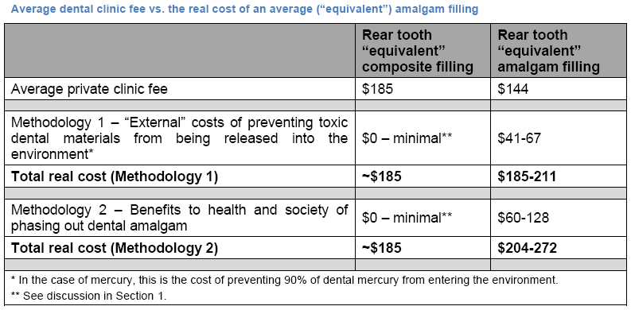
Table from 2012 study:
“Real cost of dental mercury” in the U.S.
Source: Concorde (2012)

Slide 18
Notes on “Real cost of dental mercury”
Methodology 1:
Trying to keep most of the dental mercury out of the environment, if feasible, would add about 40% to the basic fee for an amalgam filling in the U.S.
Methodology 2:
If much of the dental mercury is released into the environment, the cost to human health and society, at the time of this study, would add about 60% to the basic fee for an amalgam filling in the U.S. (* see notes)
However, if environmental and cardiovascular effects (10 times more costly than IQ effects) were now to be included, the real cost to human health and society in the U.S. would be equivalent to 2 to 3 times the basic fee for an amalgam filling.
Notes:
*The calculation for the 2012 report did not take into effect either costs of damage to the environment (no other research had yet quantified this), or cardiovascular effects on human health, for which there was not yet a medical consensus.
In 2012, recognized health effects were mostly related to reduced IQ due to MeHg exposure through fish consumption.

Slide 19
Conclusions
The use of dental amalgam inevitably leads to mercury releases.
Controlling dental mercury releases is costly, but not controlling releases is even more costly.
The use of amalgam imposes considerable additional costs on the environment and society that are not adequately reflected in current healthcare systems.
Therefore, mercury-free materials are clearly the least-cost option for dental restorations.

Slide 20
Selected references (1)
BIO Intelligence Service (2012) – Study on the potential for reducing mercury pollution from dental amalgam and batteries. DG Environment, European Commission.
Concorde (2012) – The real cost of dental mercury, Concorde East/West Sprl, 2012.
Cowi/Concorde (2008) – Options for reducing mercury use in products and applications, and the fate of mercury already circulating in society. DG Environment, European Commission.
ECHA (2010) – Annex XV Restriction Report: Mercury in measuring devices. Appendix 2: Review of literature estimating the compliance costs, human health benefits and restoration costs of reduced mercury emissions to support assessment of the cost-effectiveness. European Chemicals Agency, 15 June 2010.
Ha E, Basu N, Böse-O'Reilly S, Dórea JG, McSorley E, Sakamoto M, Chan HM (2017) – Current progress on understanding the impact of mercury on human health. Environ Res. 152:419-433.
Hylander LD and Goodsite ME (2006) – Environmental costs of mercury pollution. Science of the Total Environment 368: 352-370.
Karagas MR, Choi AL, Oken E, Horvat M, Schoeny R, Kamai E, Cowell W, Grandjean P, Korrick S (2012). Evidence on the human health effects of low-level methylmercury exposure. Environ Health Perspect. 120(6):799-806.

Slide 21
Selected references (2)
Gilmour, CC, M Podar, AL Bullock, AM Graham, SD Brown, A.C. Somenhally, A. Johs, R.A. Hurt Jr., K.L. Bailey, D.A. Elias. 2013. Mercury methylation by novel microorganisms from new environments. Environmental Science and Technology 47:11810-11820
Scheuhammer, A.M., N. Basu, D.C. Evers, G.H. Heinz, M.B. Sandheinrich, and M.S. Bank. 2011
WHO/UNEP/IOMC (2008), Guidance for identifying populations at risk from mercury exposure. http://www.who.int/foodsafety/publications/chem/mercuryexposure.pdf
Mergler D, Anderson HA, Chan LH, Mahaffey KR, Murray M, Sakamoto M, Stern AH. 2007. Panel on Health Risks and Toxicological Effects of Methylmercury. Methylmercury exposure and health effects in humans: a worldwide concern. Ambio. 36(1):3-11.
Clarkson TW, Magos L. 2006. The toxicology of mercury and its chemical compounds. Crit Rev Toxicol. 36(8):609-62.
ATSDR 1999. Toxicological Profile for Mercury. Agency for Toxic Substances and Disease Registry. U.S. Centres for Disease Control, Atlanta, Georgia
US EPA 1997. Mercury Study Report to Congress. https://www.epa.gov/mercury/mercury-study-report-congress

Slide 22
For further information:
Peter Maxson
Concorde East/West Sprl
10 av. René Gobert
1180 Brussels
peter.maxson@gmail.com
tel. +32 2 374 3647

